Slide 1

AAD & DAD
Algorithm-aided Design
Data-aided Design
2021.11.02

Slide 2
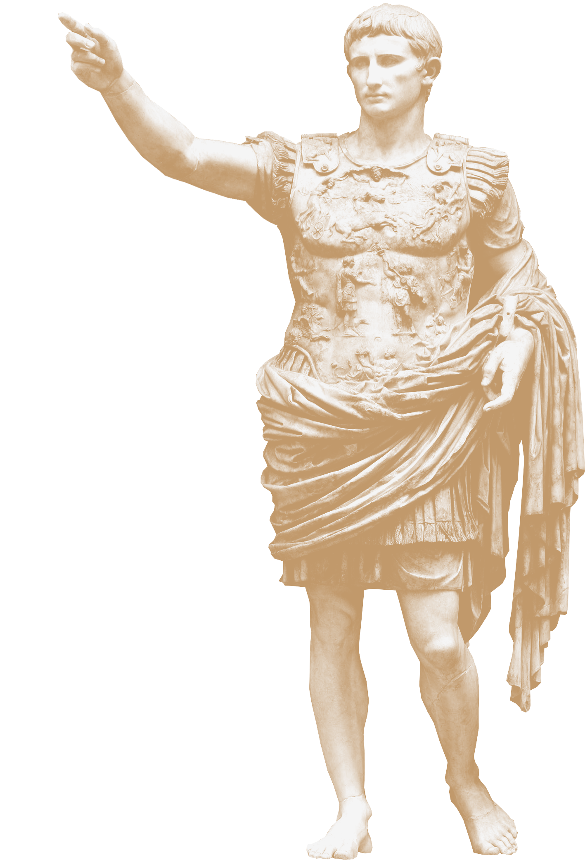
The EVOLUTION OF AN ARCHITECT
Analog
CAD
DAD
Generative
– Drawing Board
– Computer-aided Design
– Data-aided Design
– Algorithm-led Design.

Slide 3
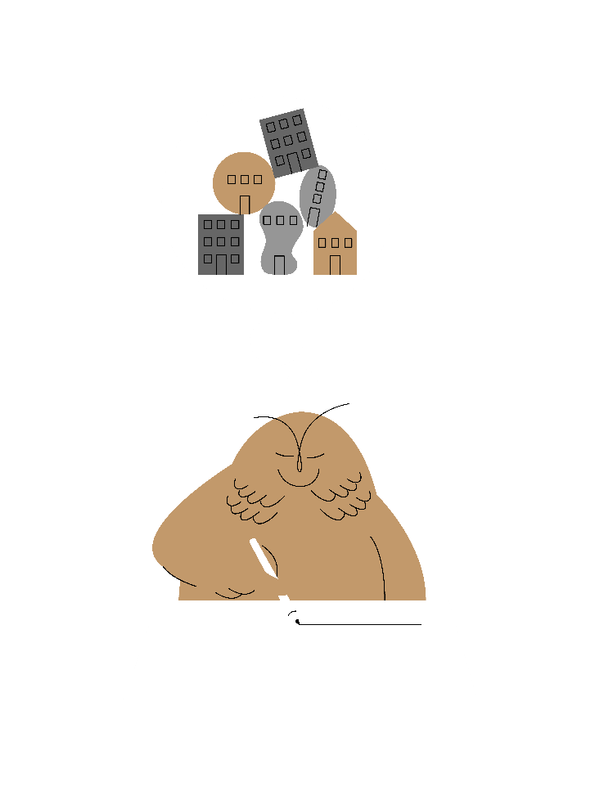
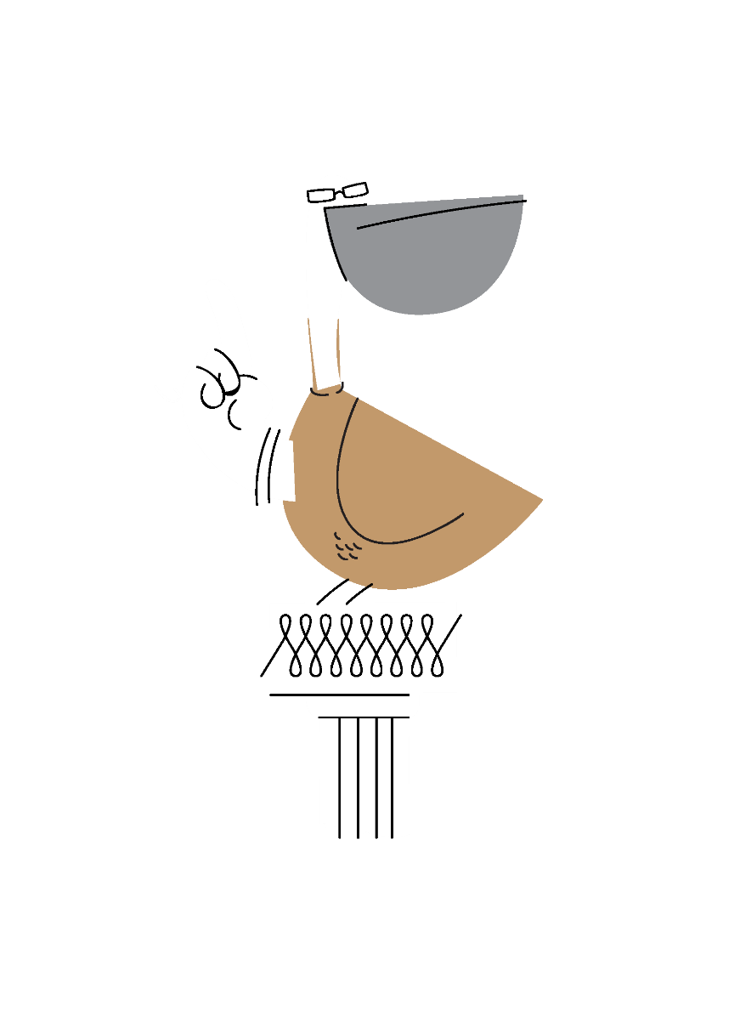
The impact of the tool
HOW WE WORK
HOW WE THINK
Product Development
Development Process

Slide 4
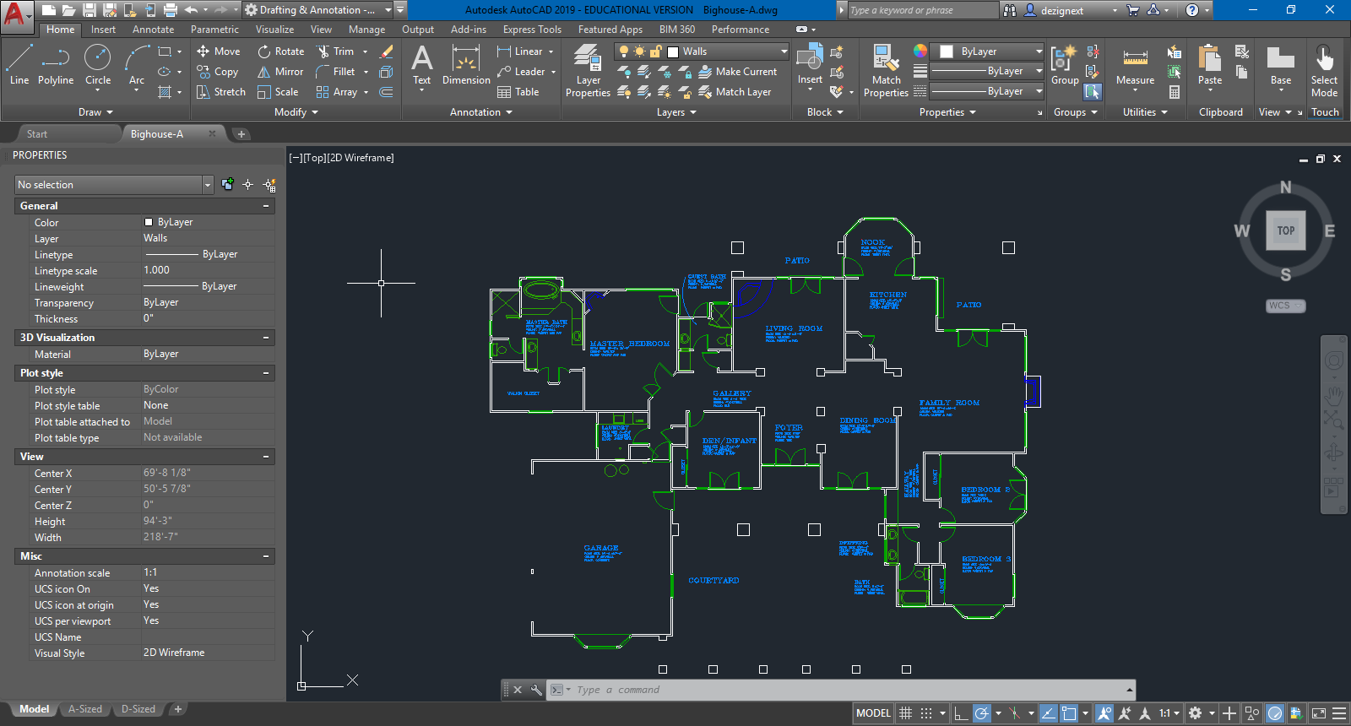
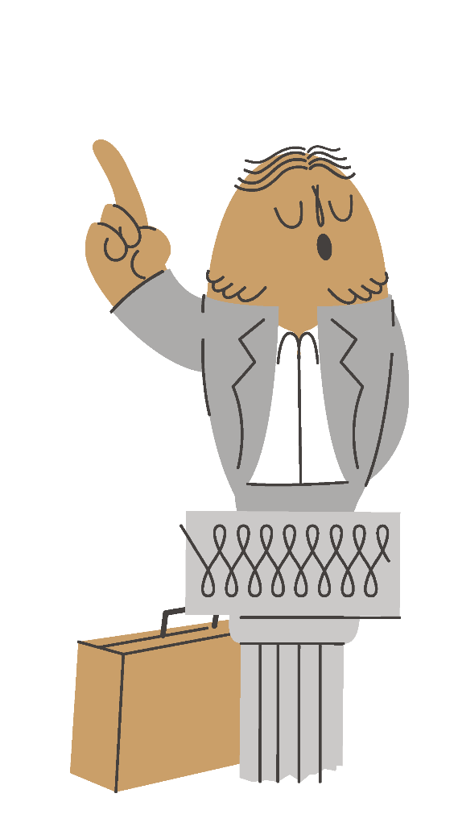
Save s
Scale s
Undo s
Copy s
Print s
Archive s
Modify s
Space s

Slide 5
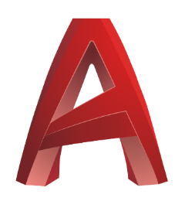
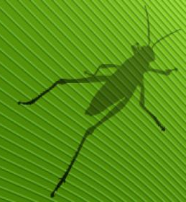
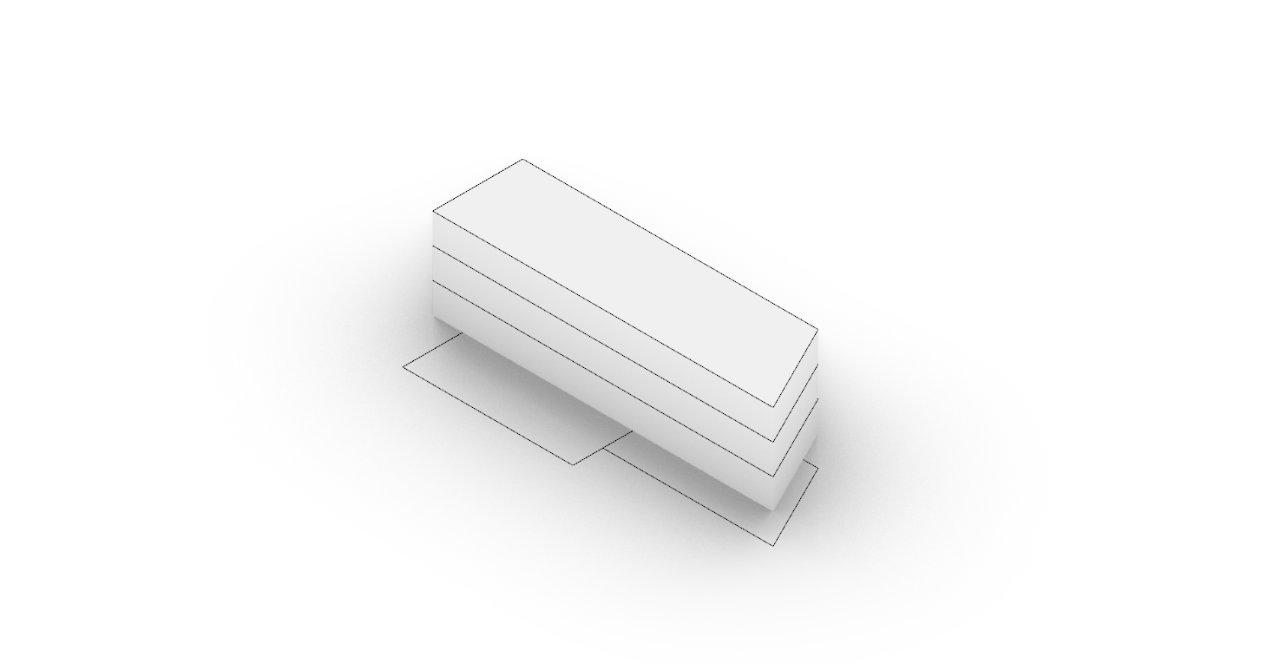
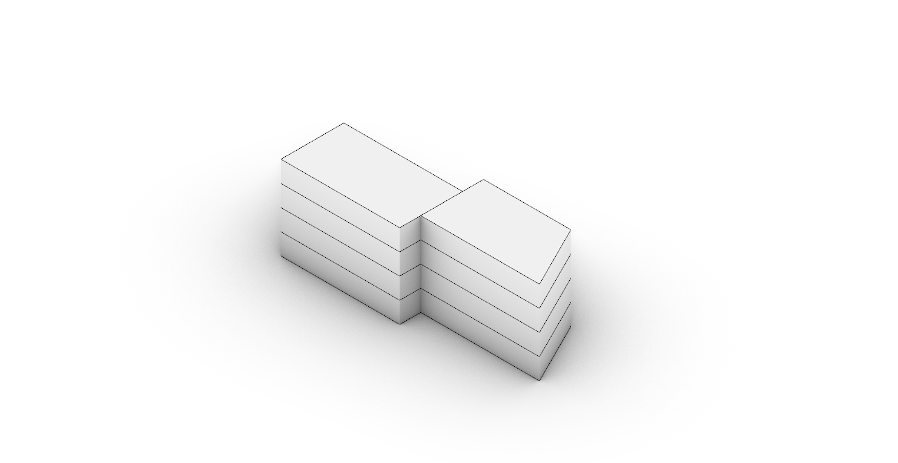
Click-Based
Direct Modelling
Nonadaptive Geometry
Unanalysable Outcome
Non-recyclable Product
Algorithm Based
Indirect Modelling
Adaptive Geometry
Analysable Outcome
Recyclable Product

Slide 6
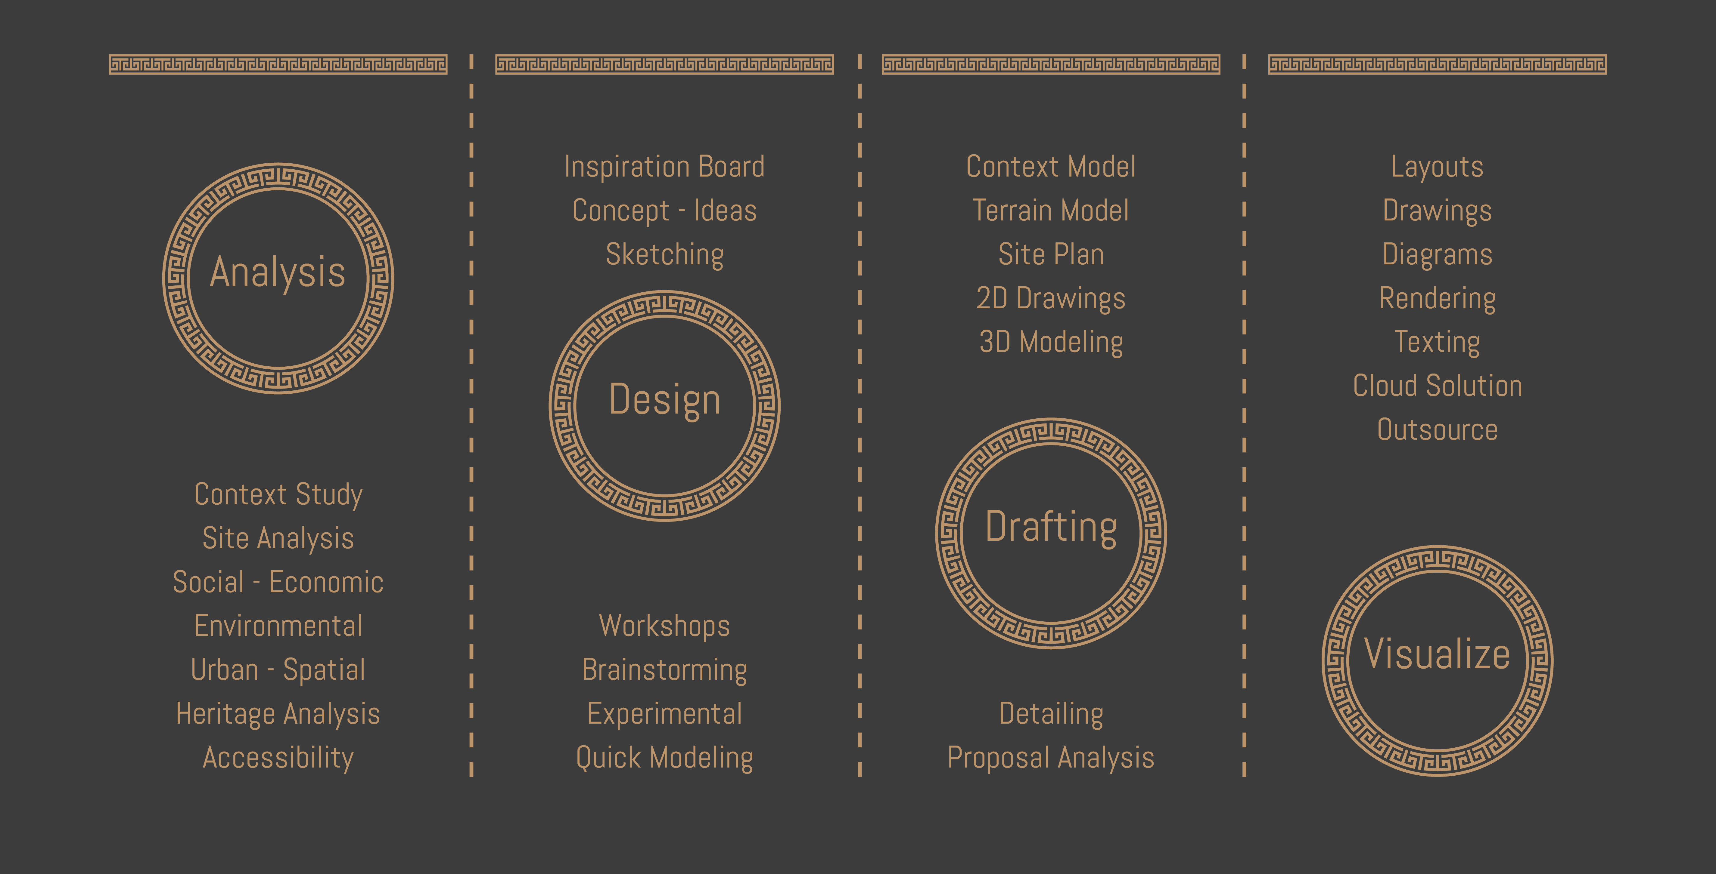
Project development
Linear Staging Process

Slide 7
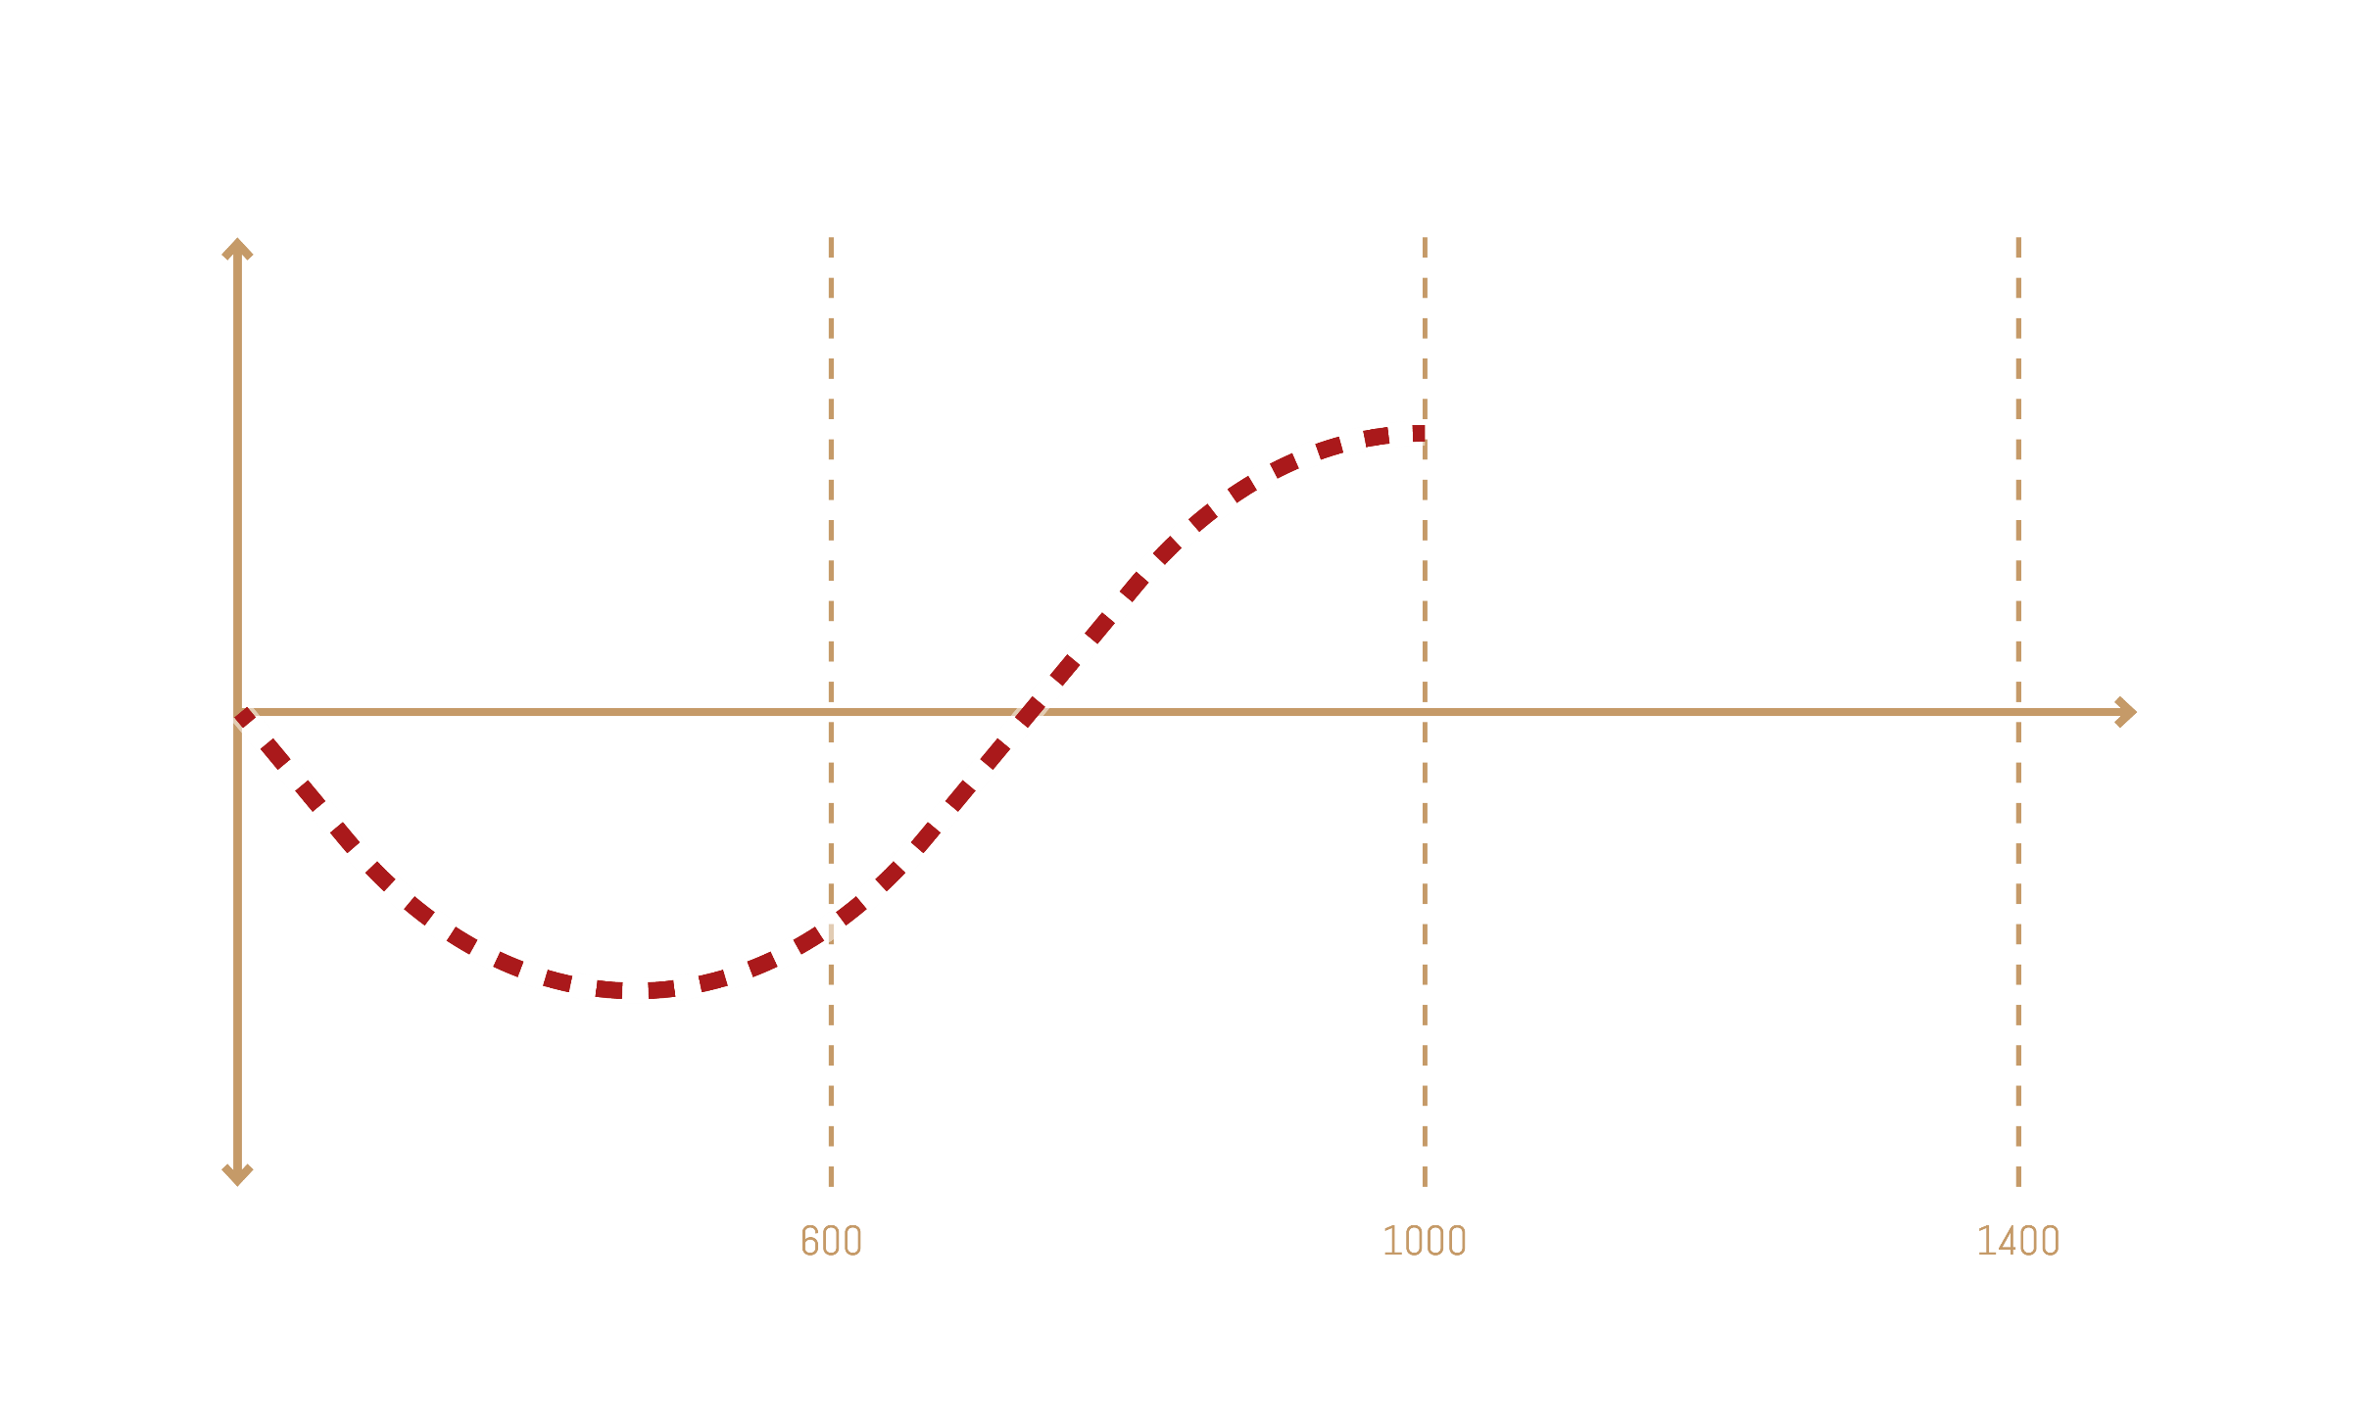
Output Quality
Project Budget
Depth of Study

Slide 8
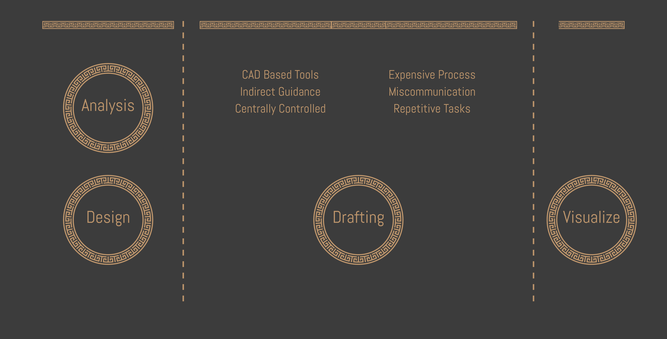
Project budget
CAD-based Process

Slide 9
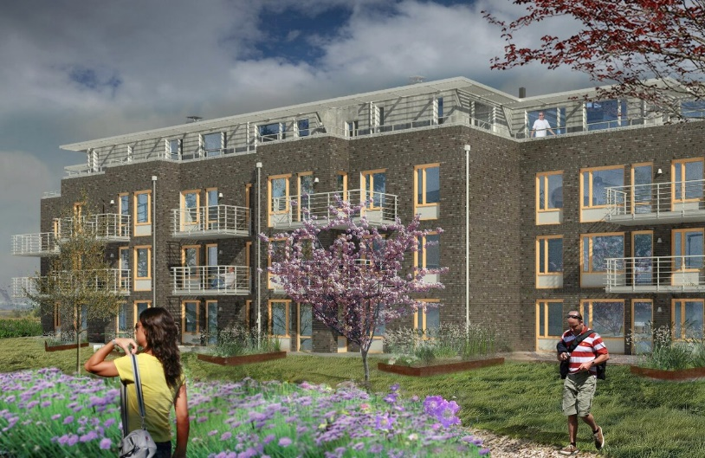
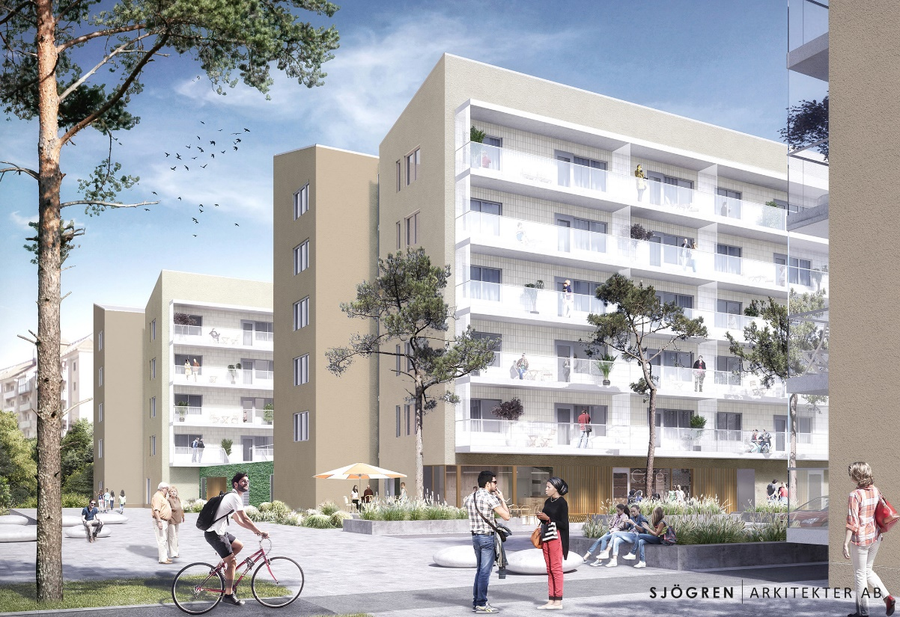
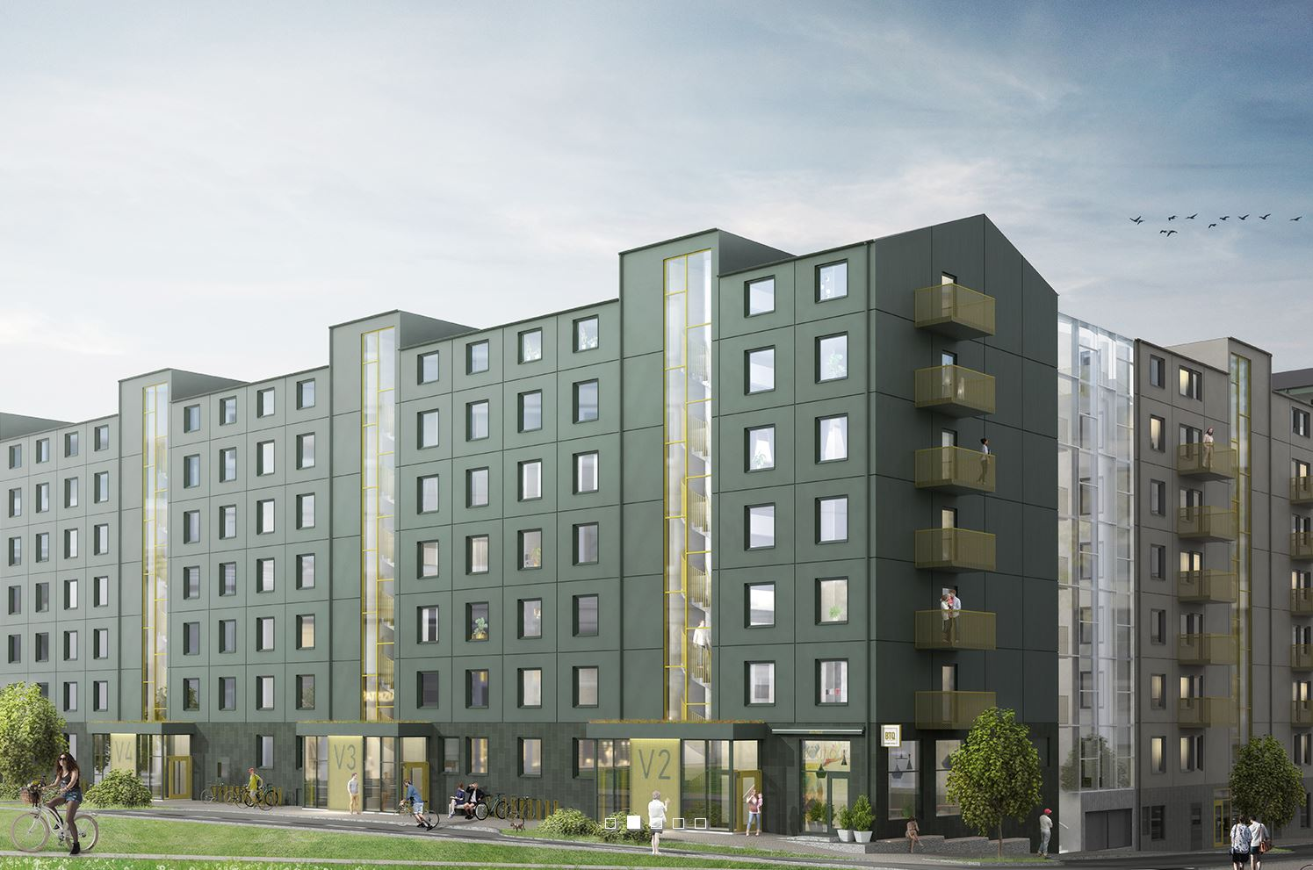
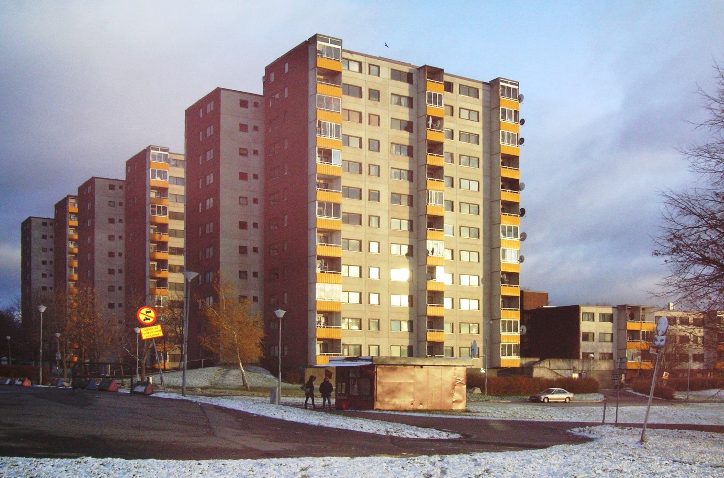
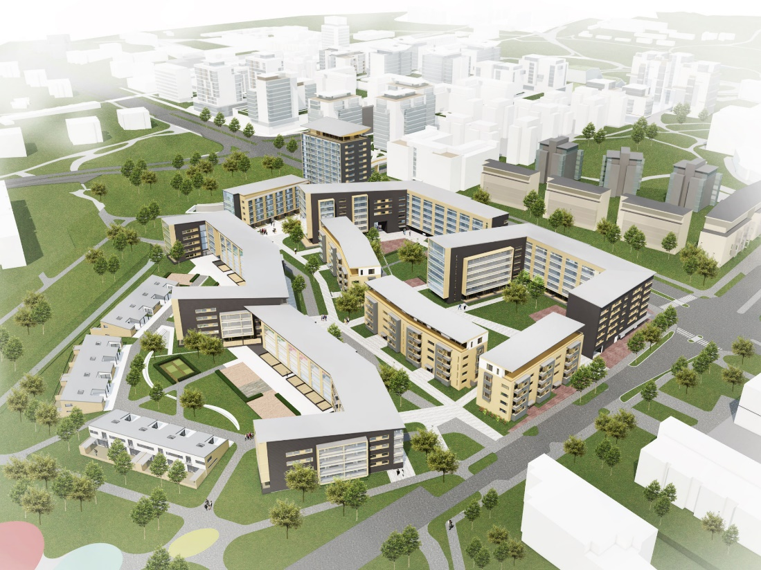
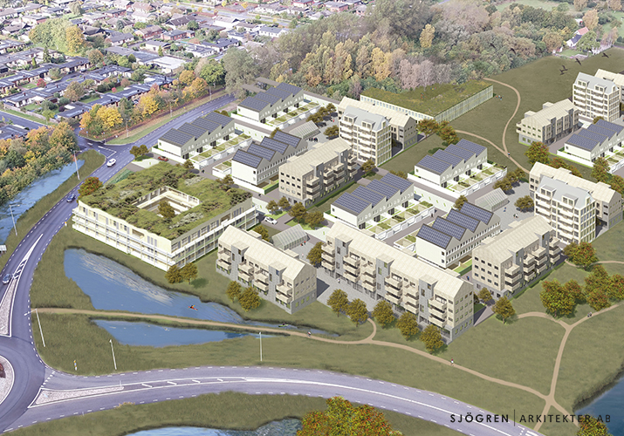

Slide 10
Project development
Linear Staging Process

Slide 11
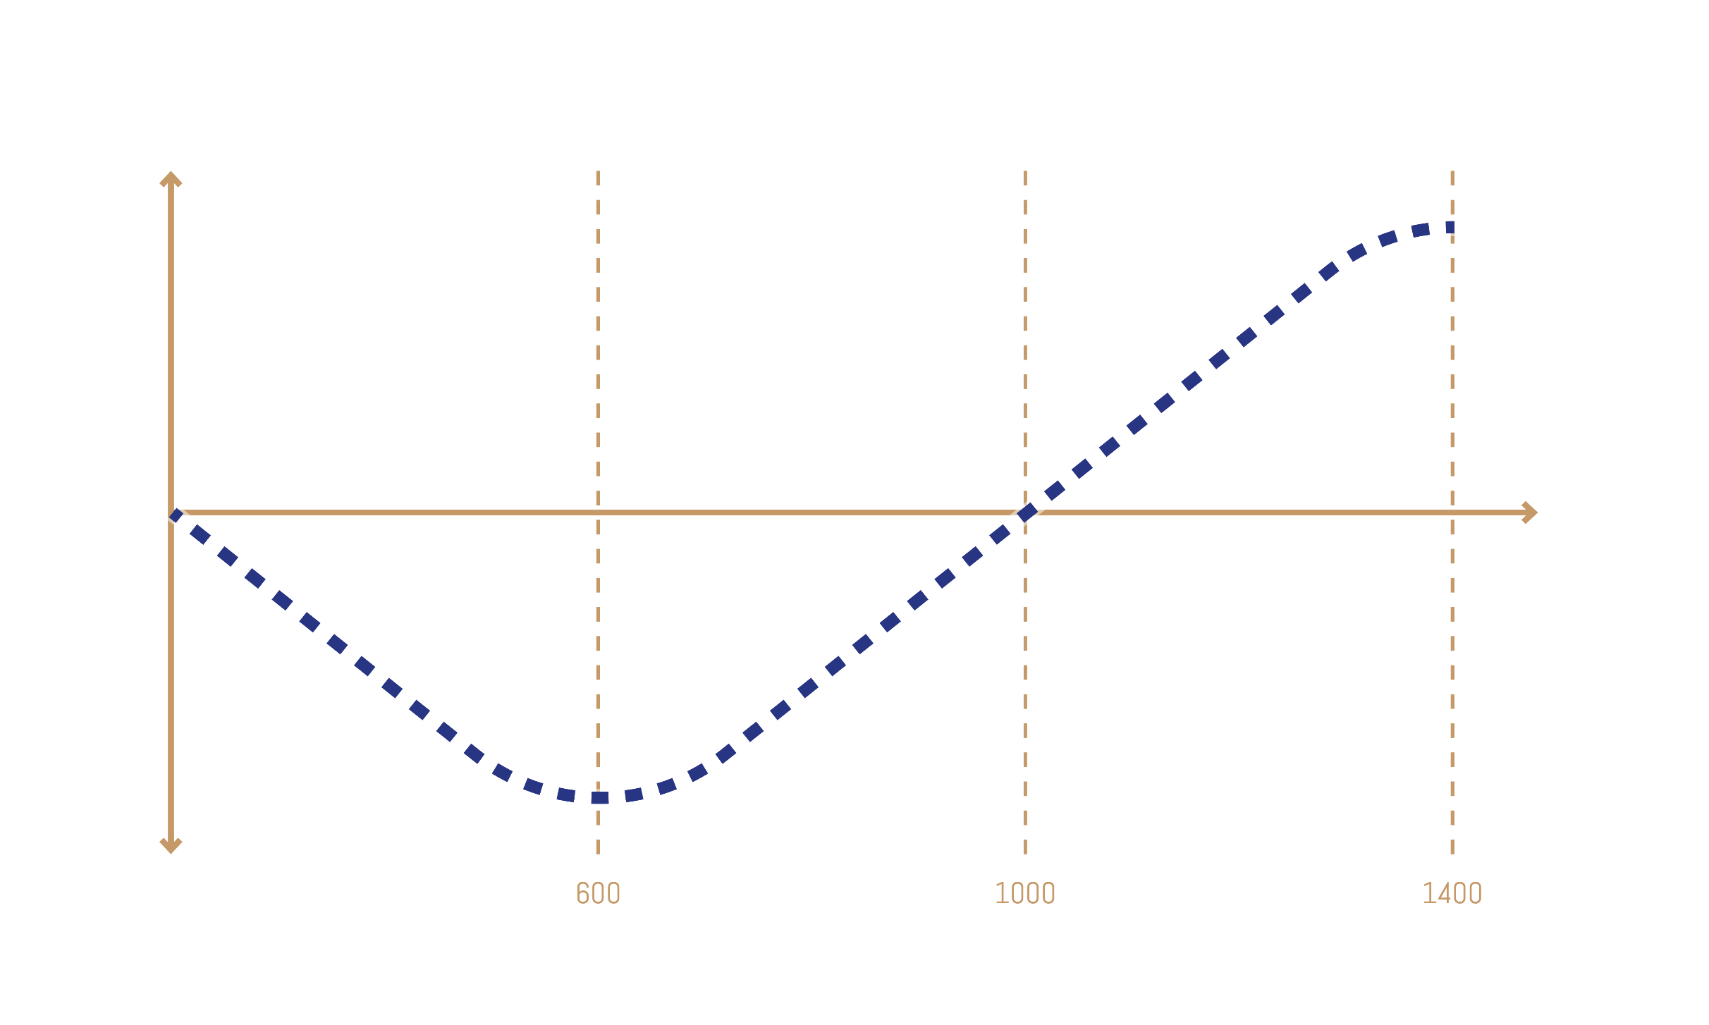
Output Quality
Project Budget
Depth of Study

Slide 12
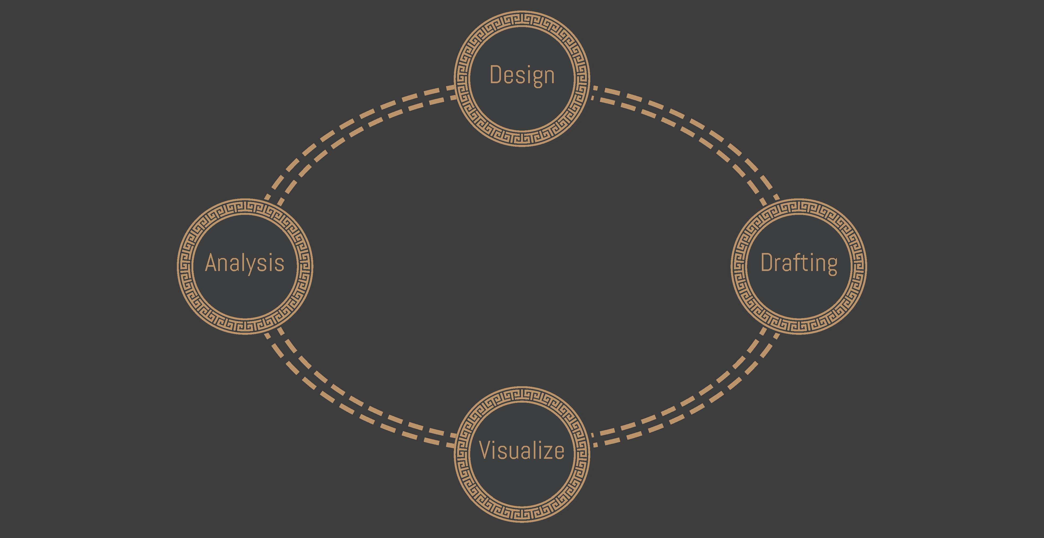
Project development
Circular Process

Slide 13
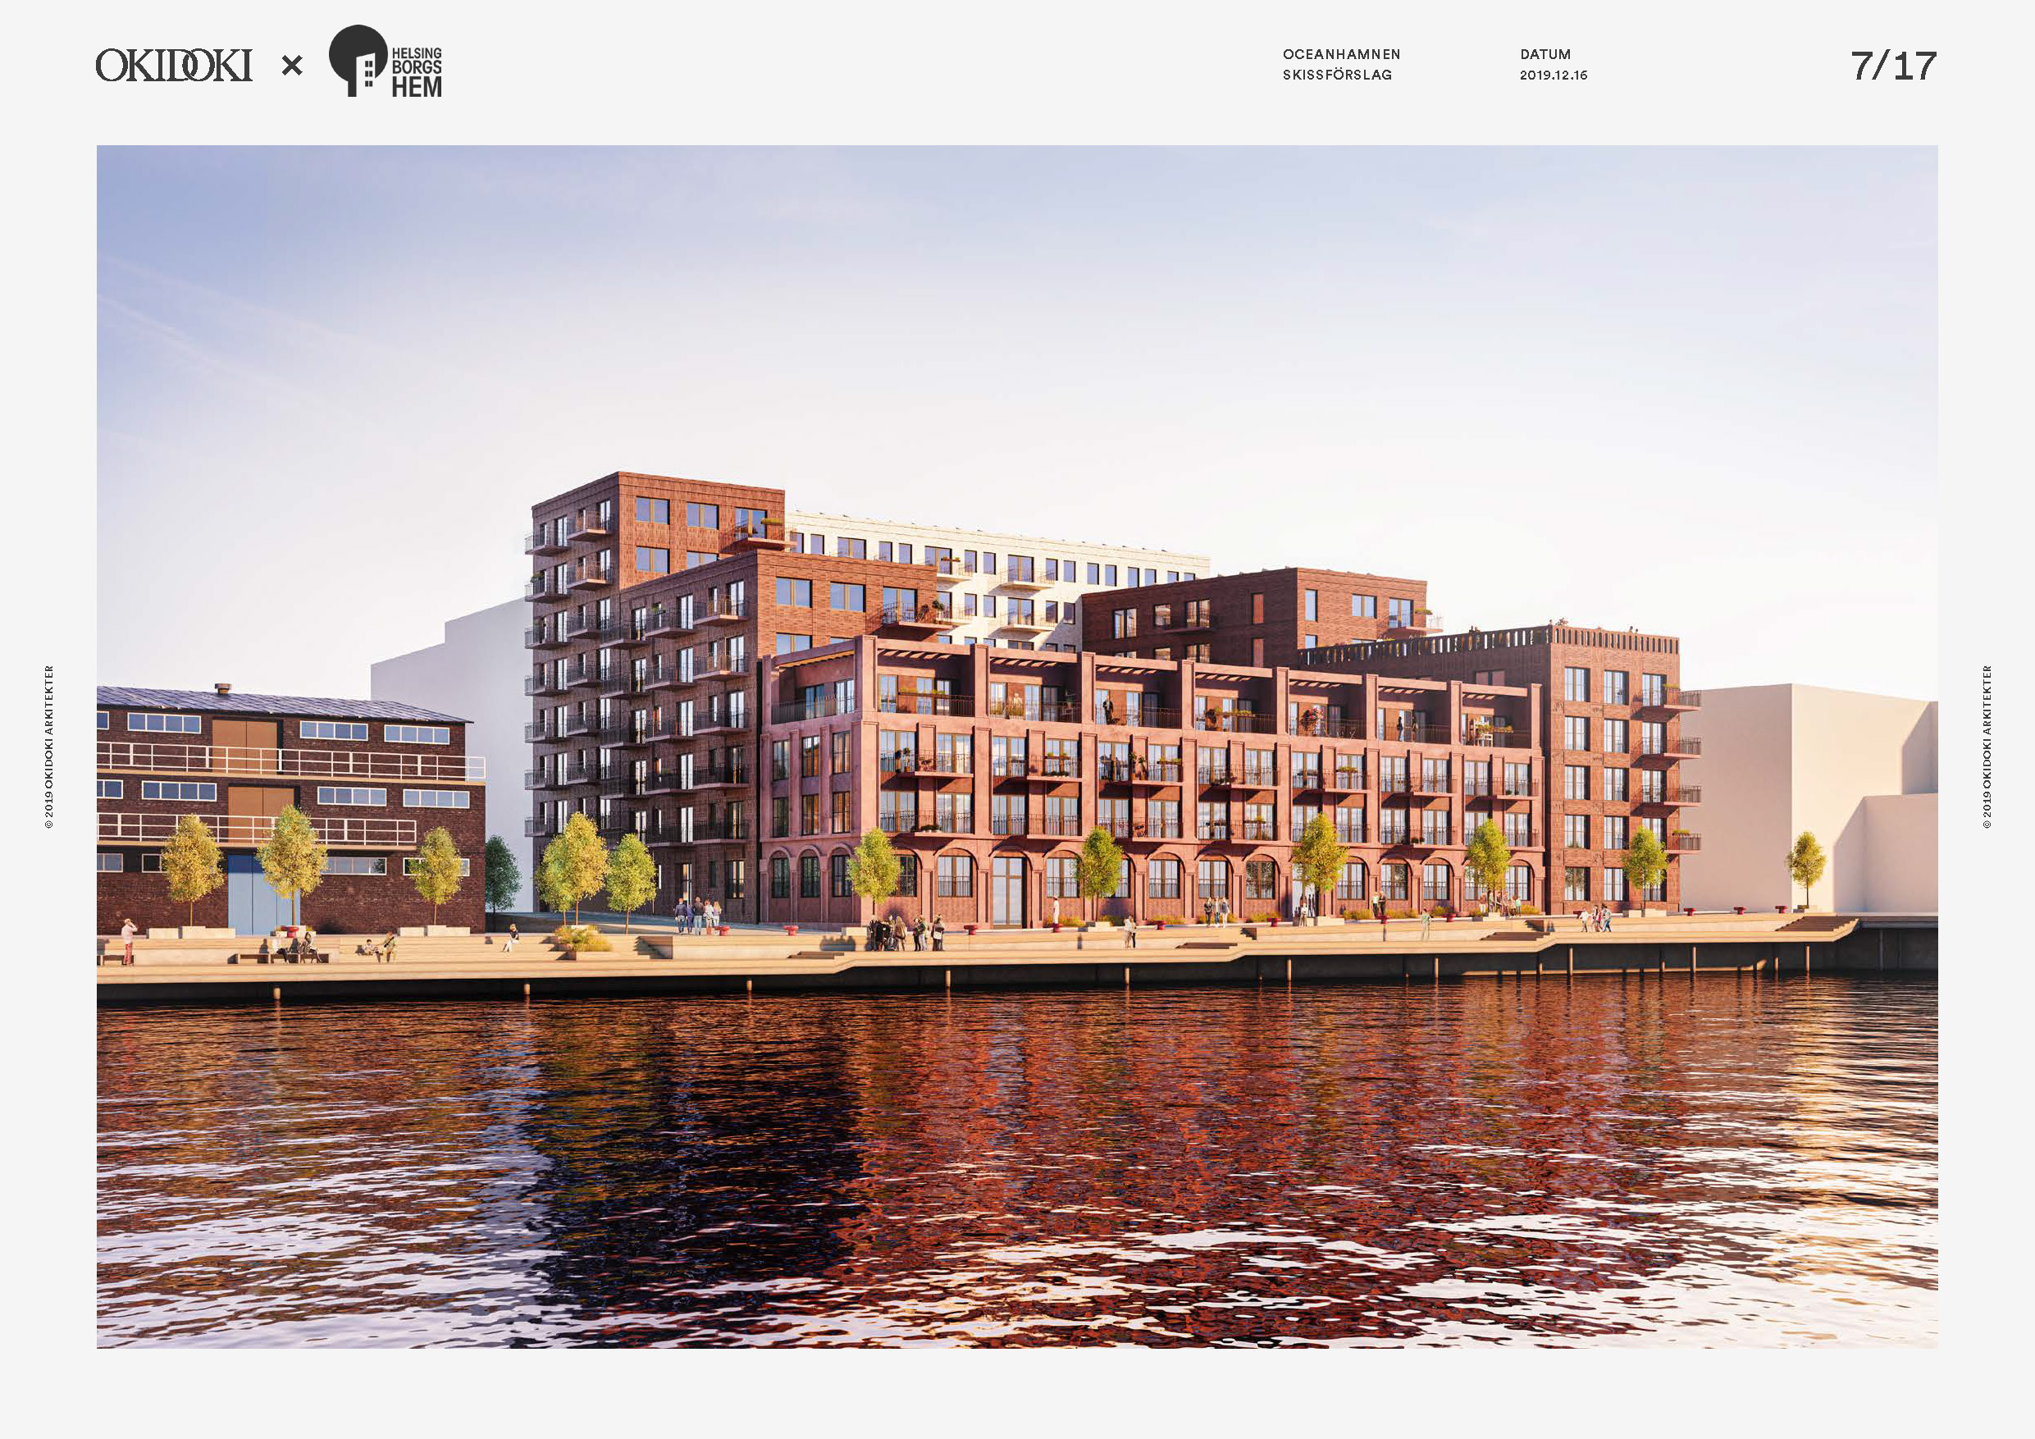
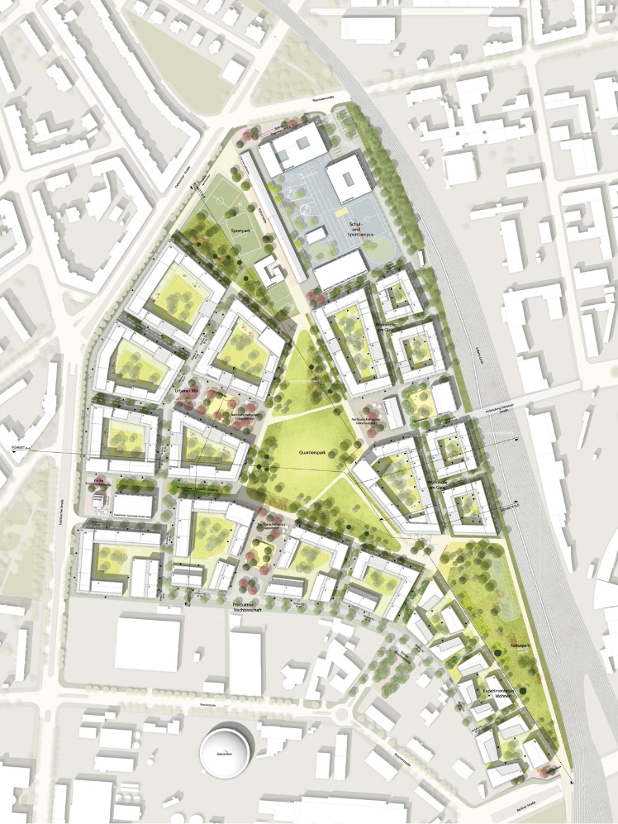
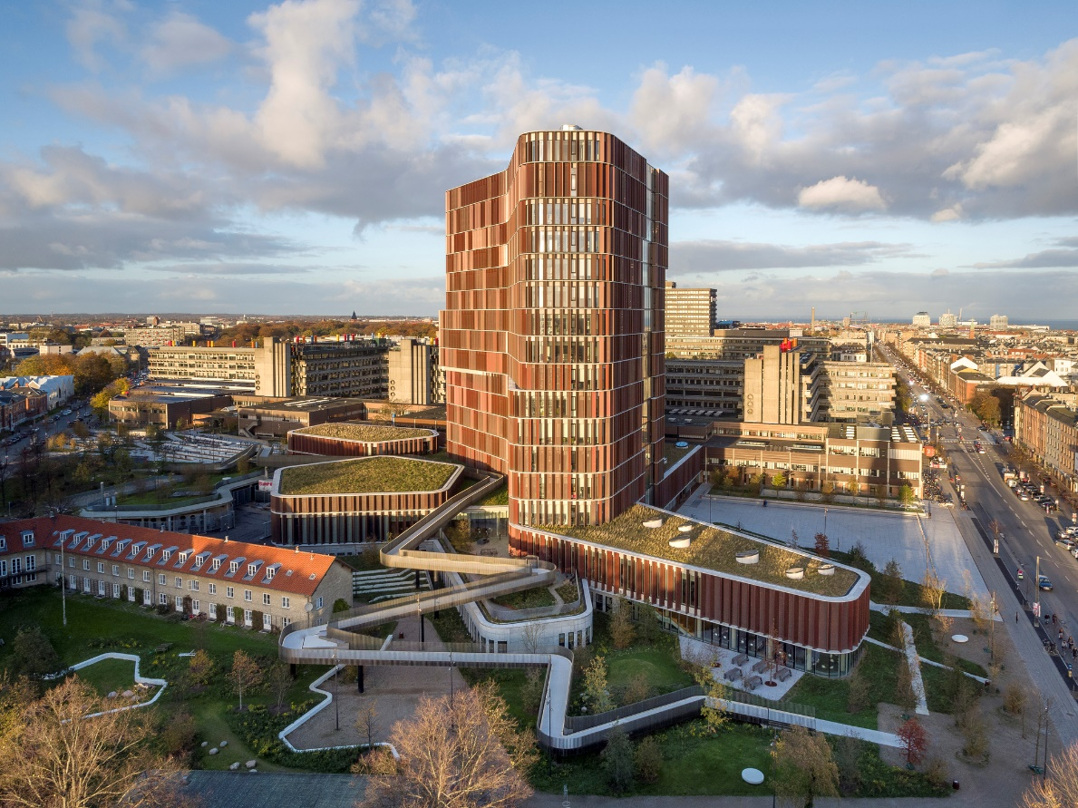
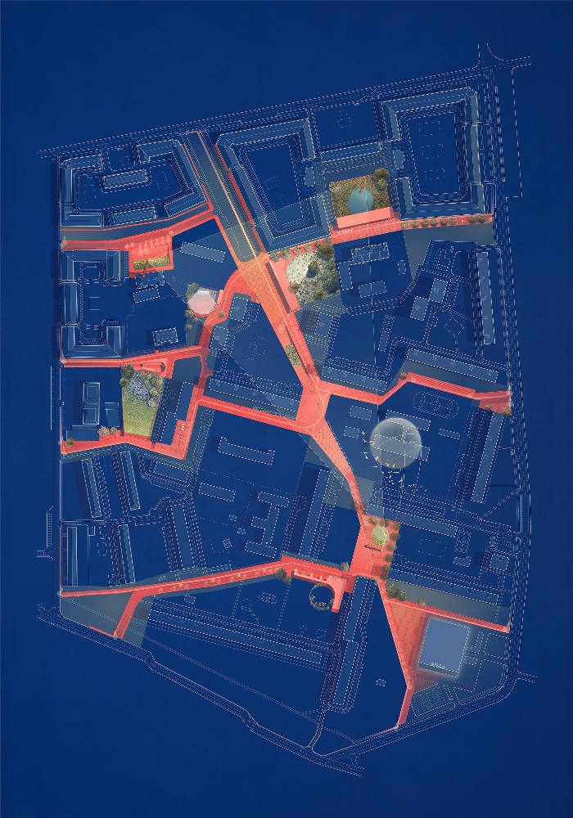
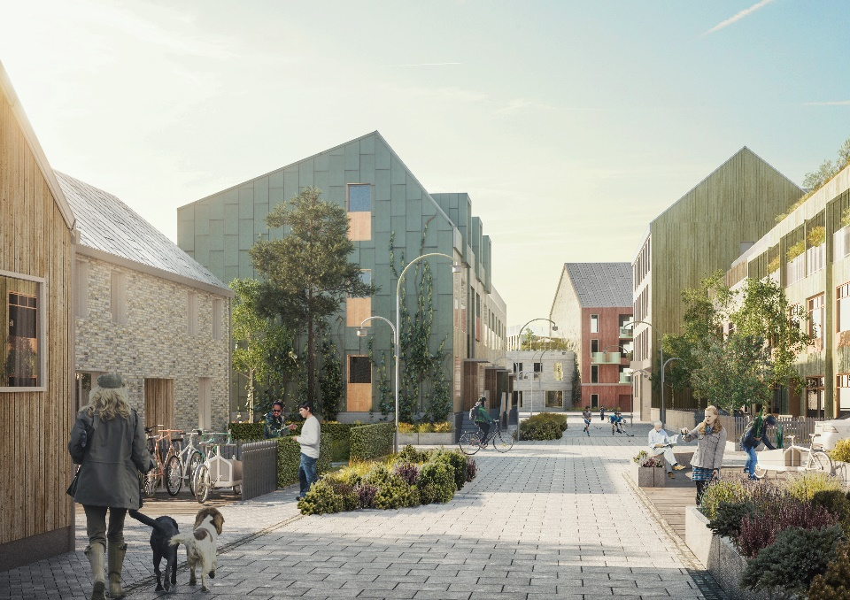
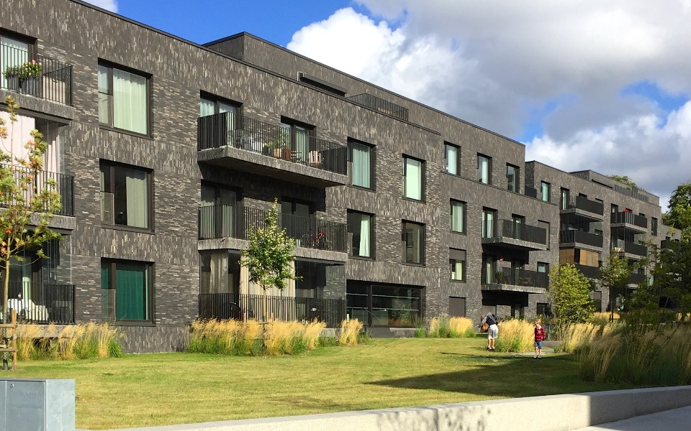

Slide 14
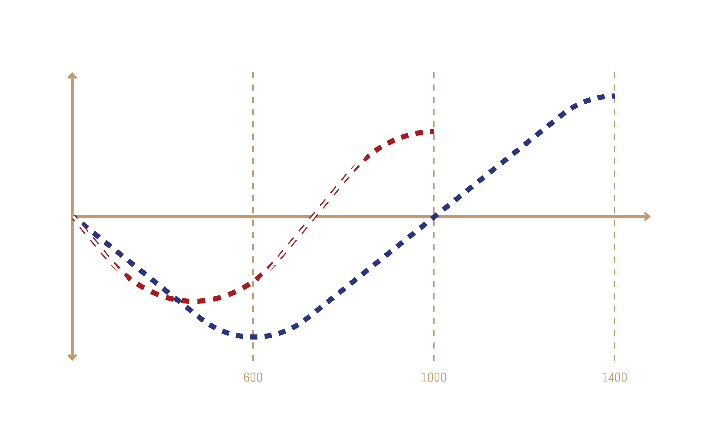
Output Quality
Project Budget
Depth of Study

Slide 15
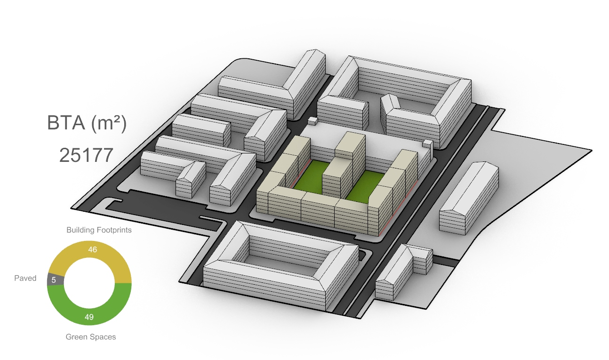
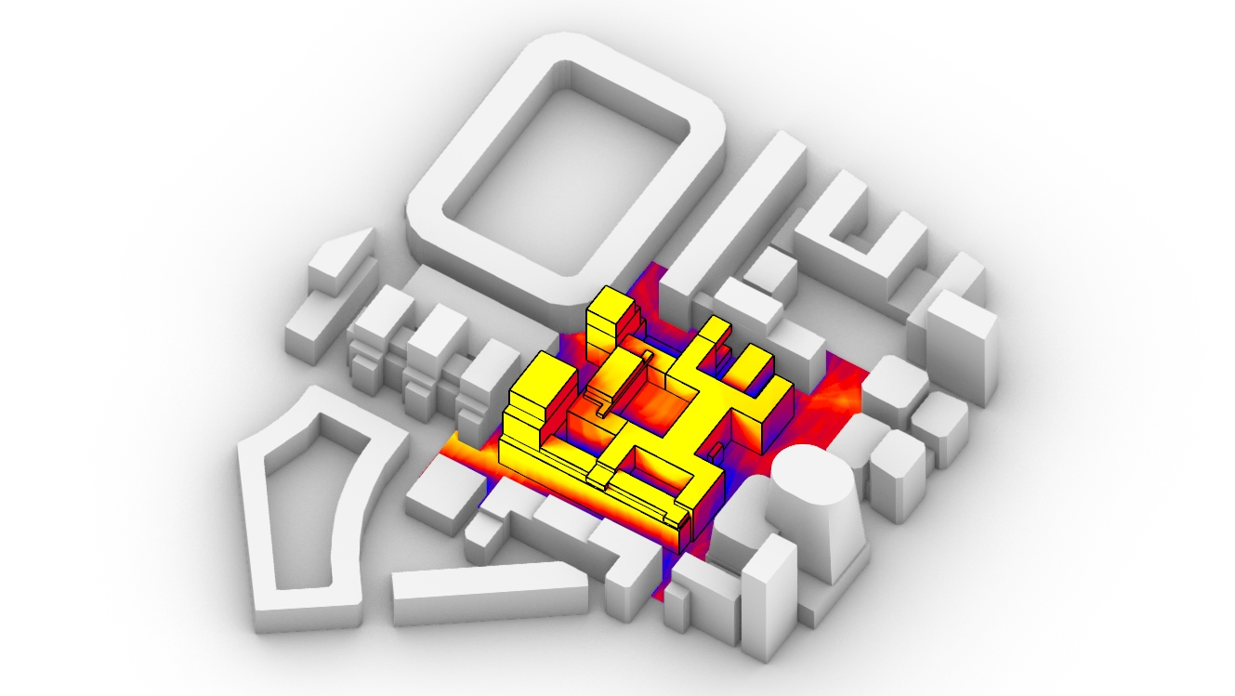
AAD & DAD
PROCESS AUTOMATION
ANALYTIC SYSTEM
Drafting & Design Tools
Data Aided Approach

Slide 16
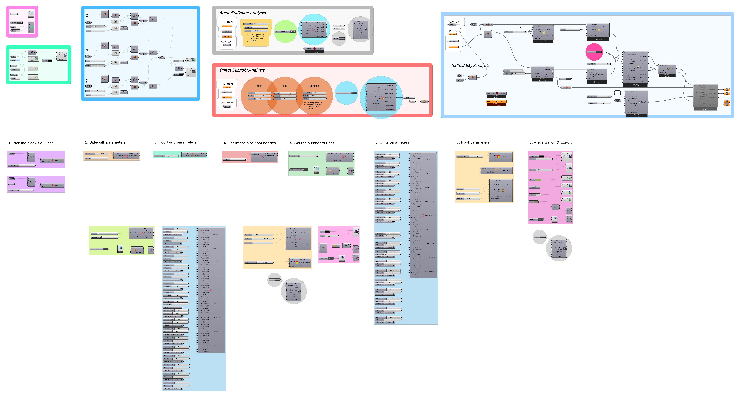
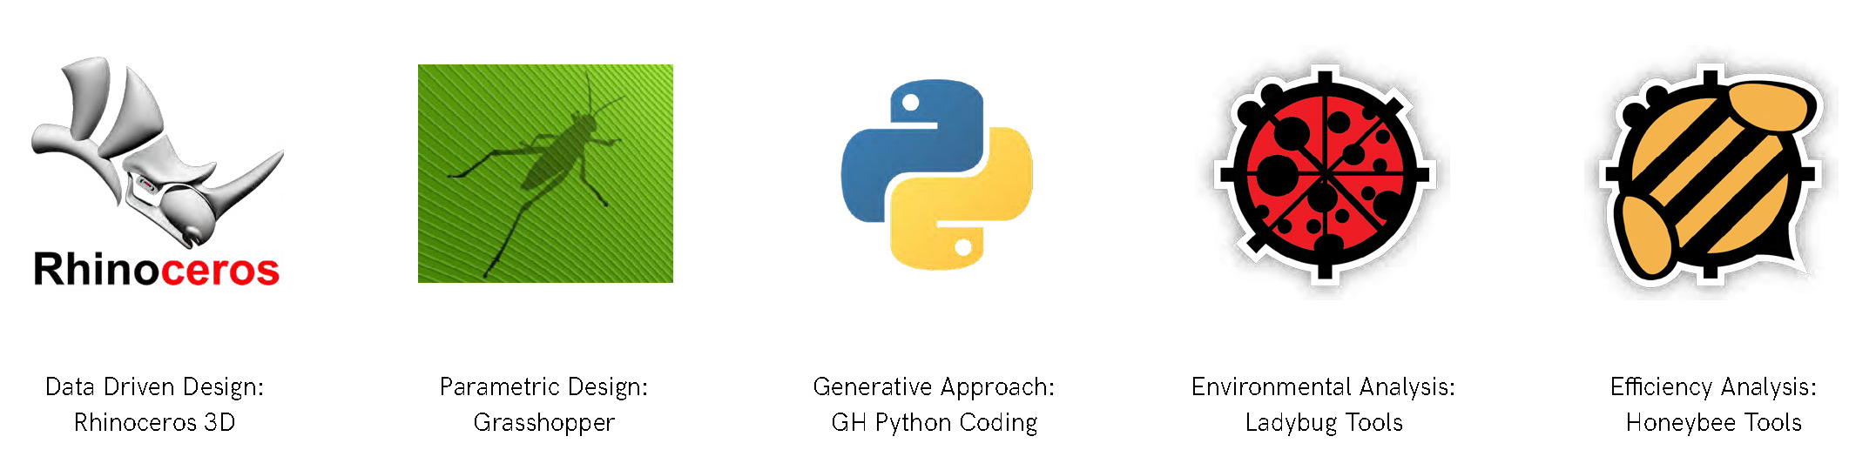

Slide 17
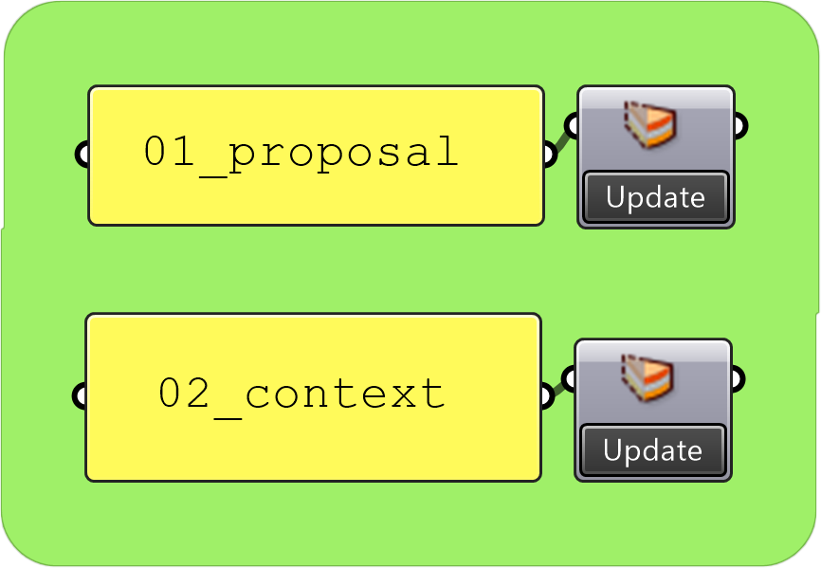
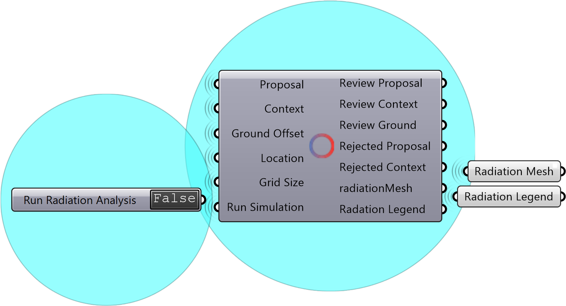
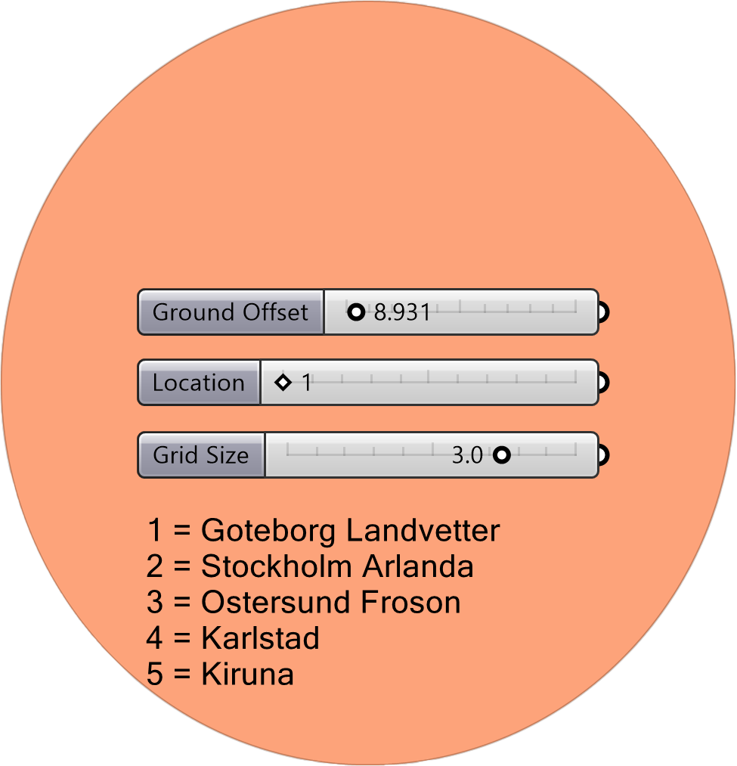
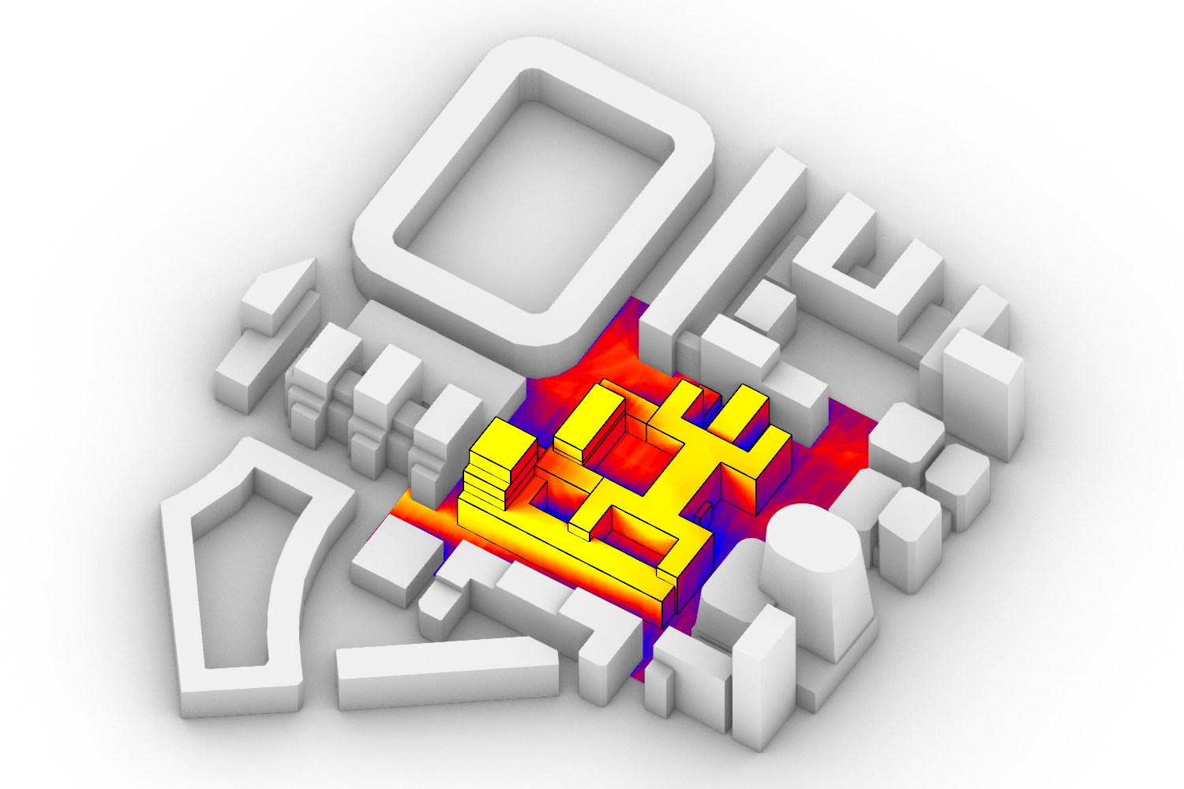
AAD & DAD
COMPLEX SCRIPTS
USER FRIENDLY TOOLS
Grasshopper + Rhino
Basic Knowledge of Rhino
3
Run
1
Import
4
2
Enjoy
Choose

Slide 18
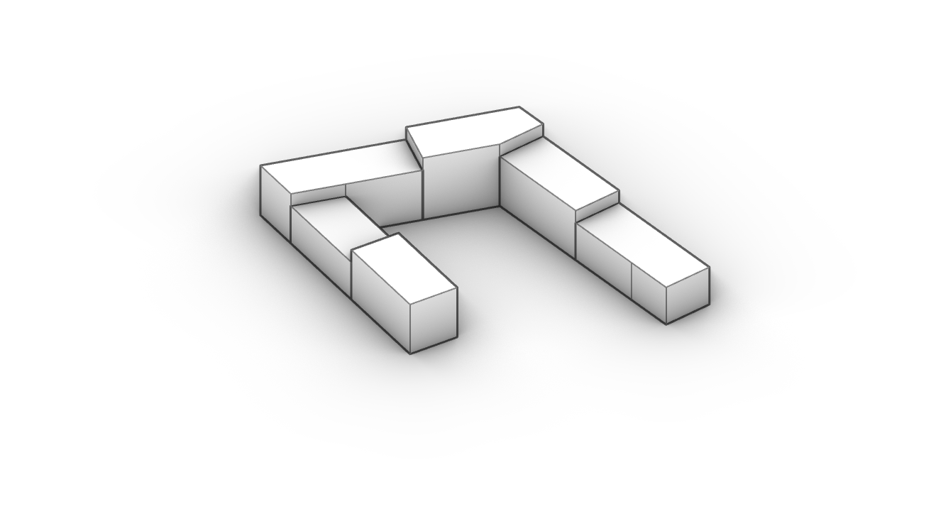
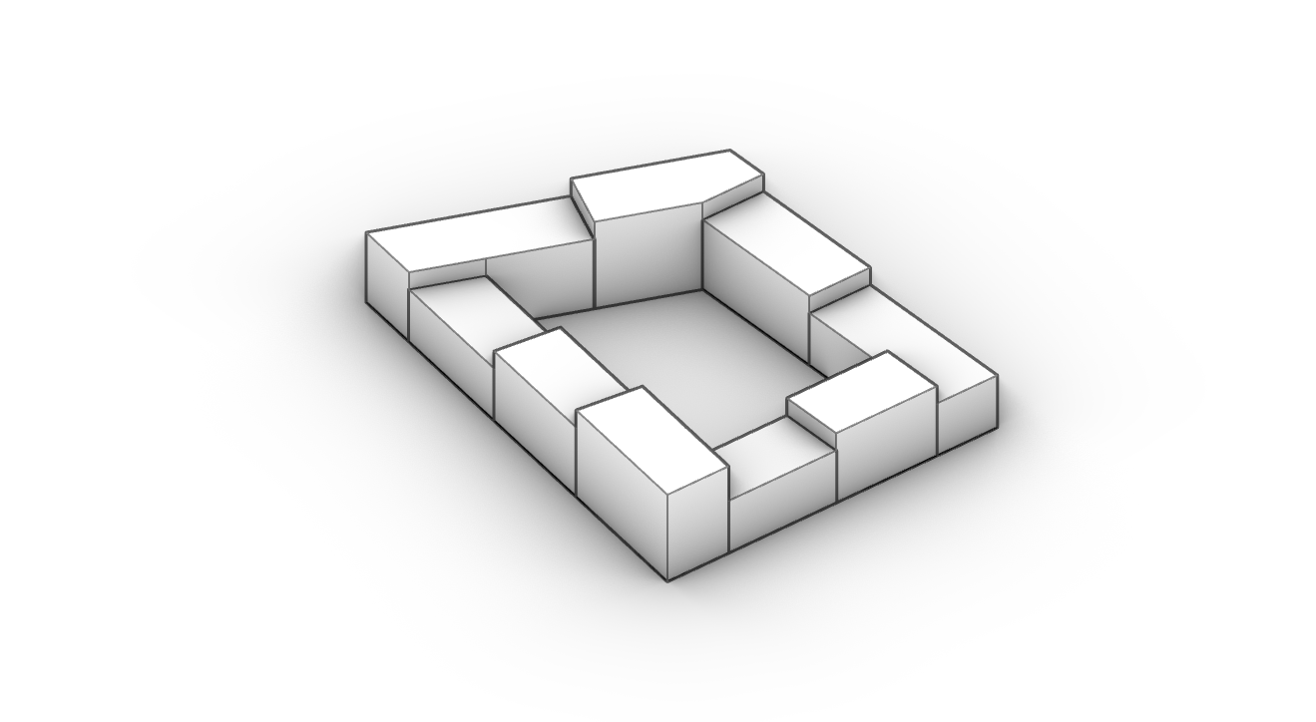
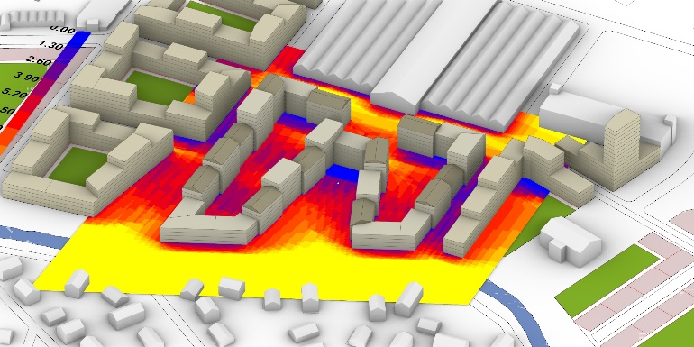
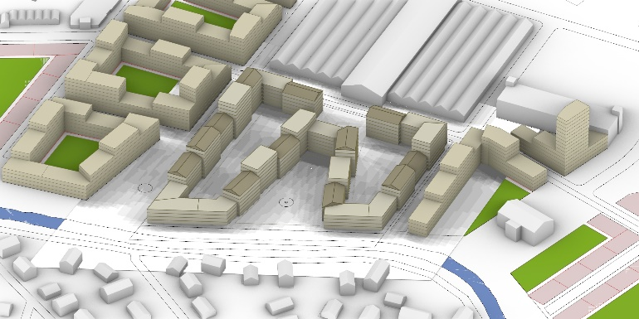
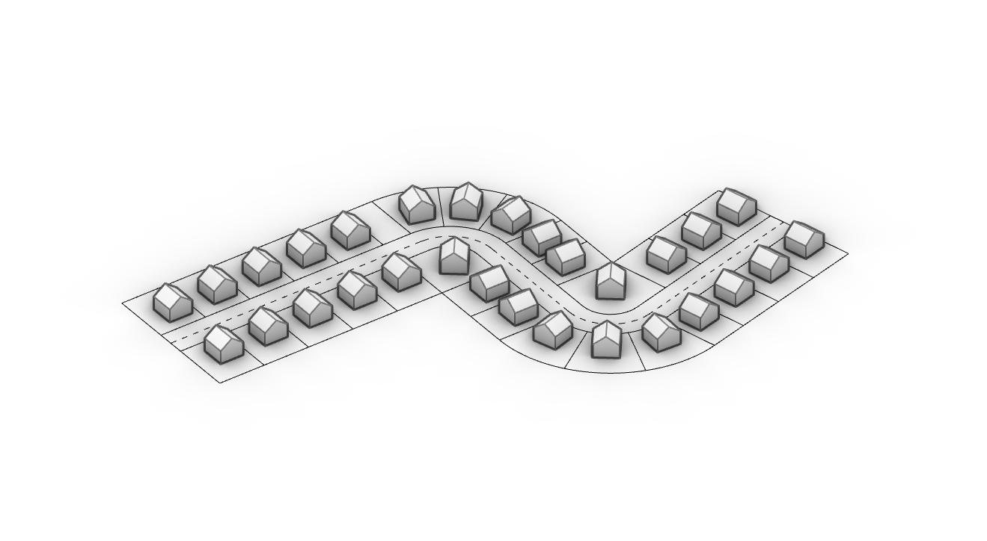
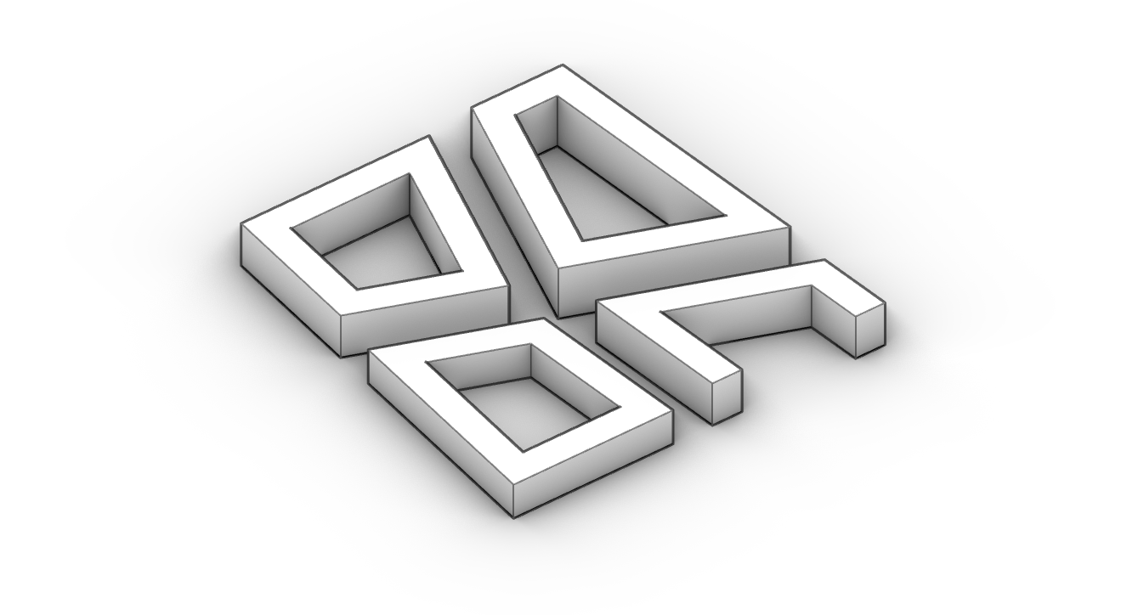
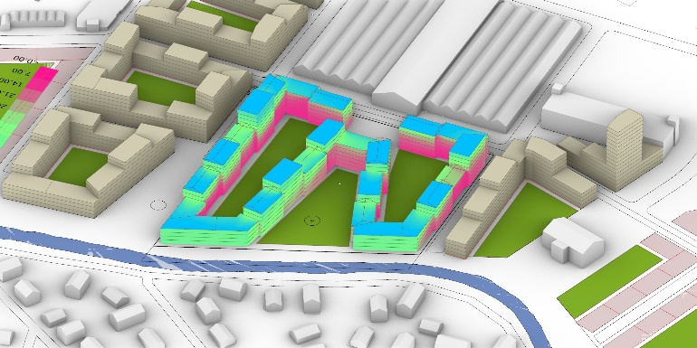
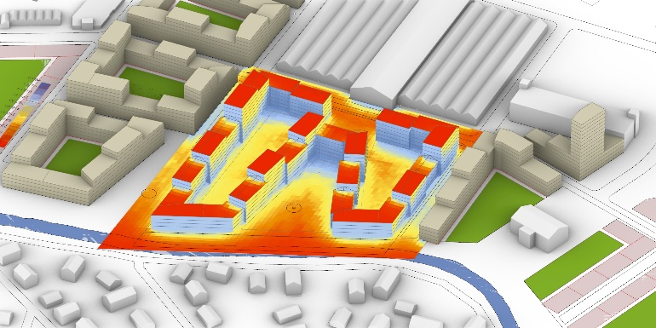
AAD & DAD
PROCESS AUTOMATION
ANALYTIC SYSTEM
Drafting & Design Tools
Data Aided Approach
Open Block
Closed Block
Direct Sunlight
Shadow Simulator
Multi Block
Multi Family Houses
Access to View
Solar Radiation

Slide 19
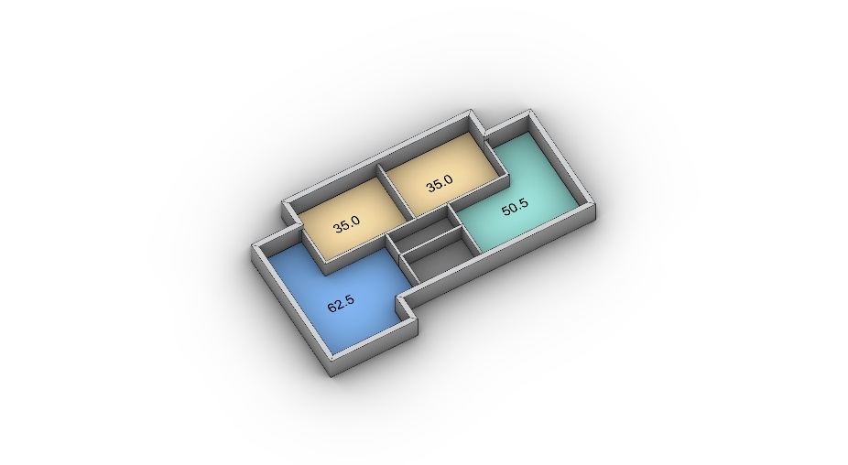
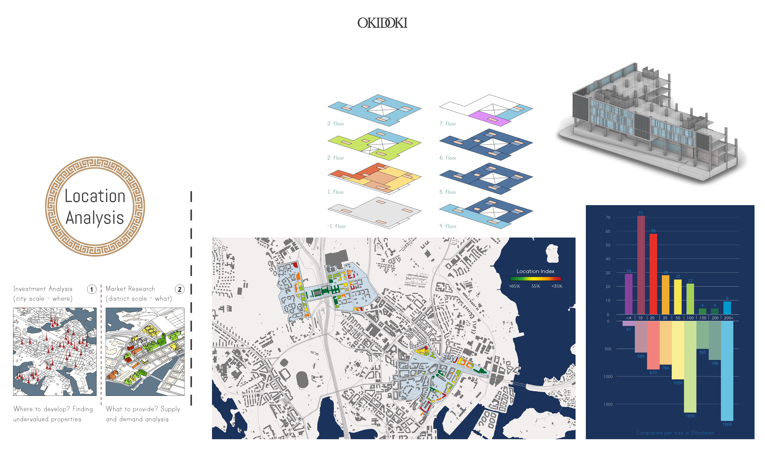
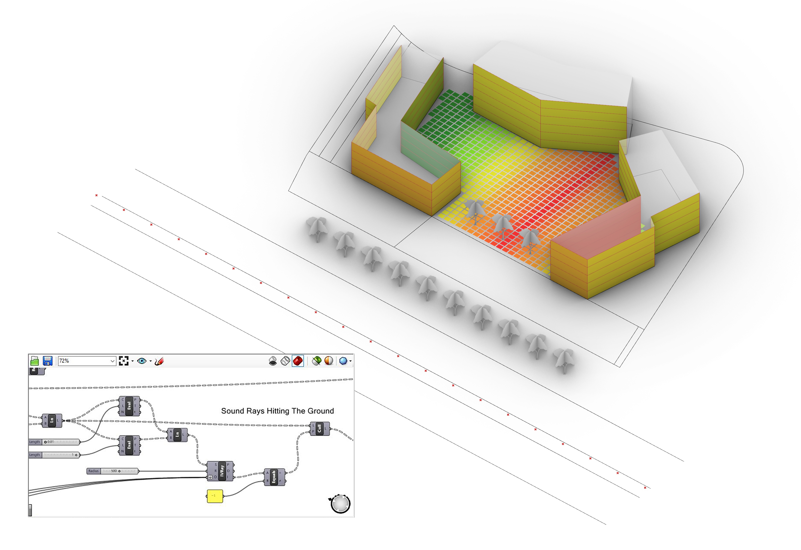
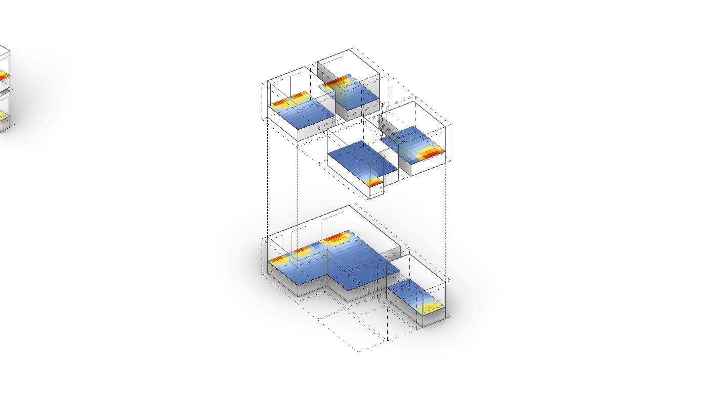
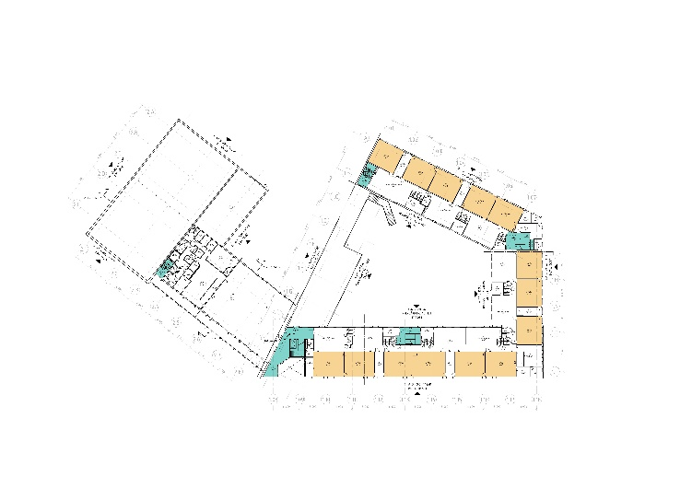
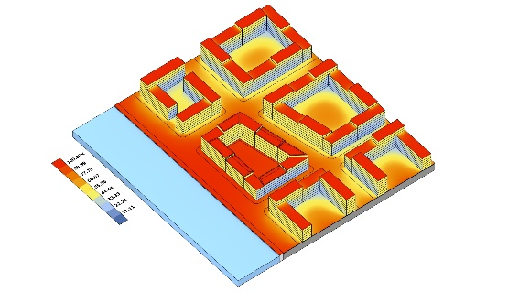
AAD & DAD
PROCESS AUTOMATION
ANALYTIC SYSTEM
Drafting & Design Tools
Data Aided Approach
Floor Plan Tool
Facade Drafter
Traffic Noise
Educational Facilities Planner
Vertical Sky Component
Daylight Factor

Slide 20

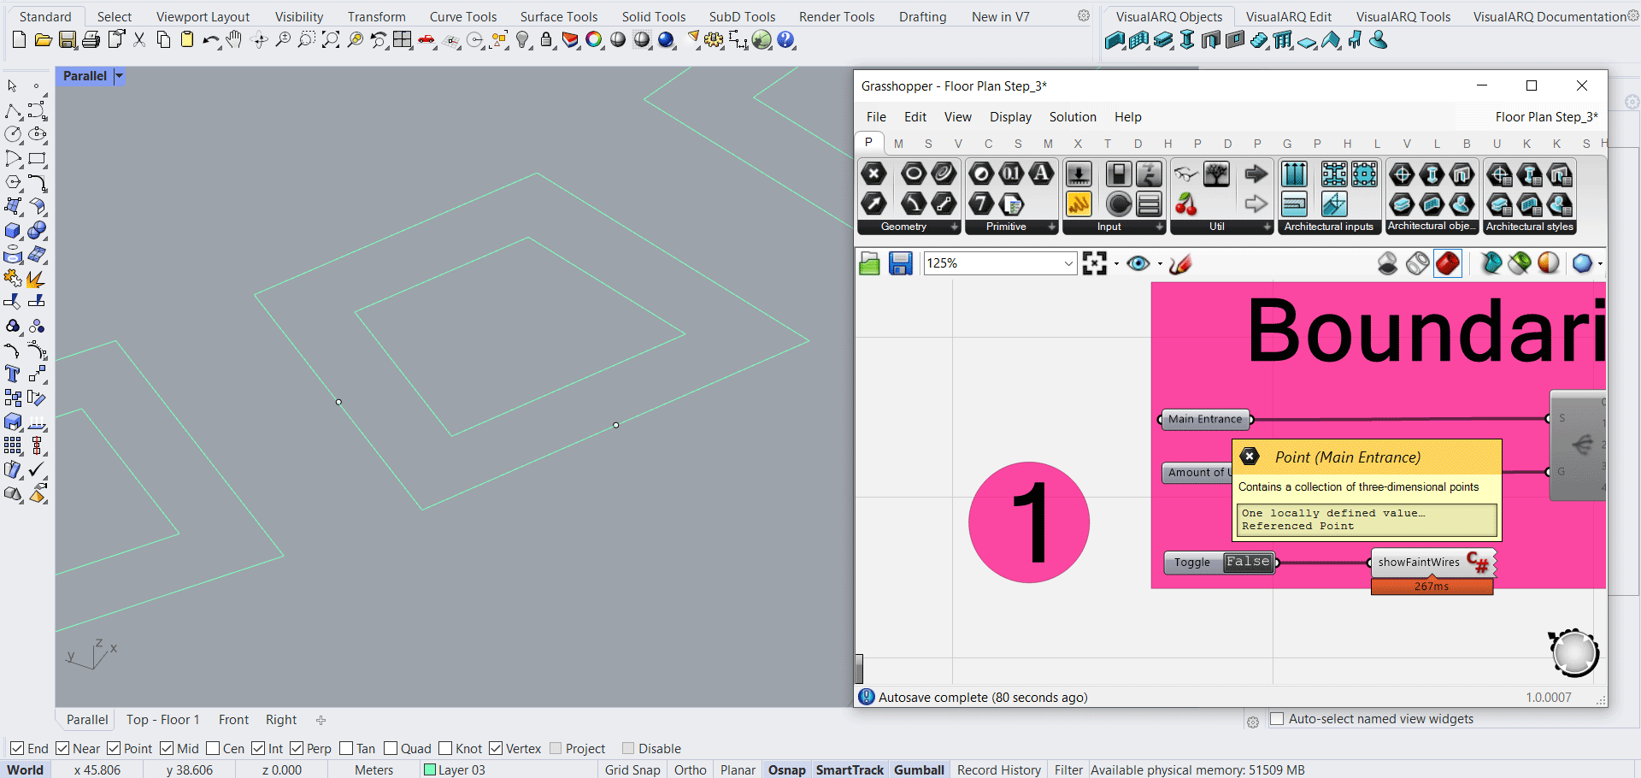
AAD & DAD
PROCESS AUTOMATION
ANALYTIC SYSTEM
= Higher Margin + Operational Scaling
= More Accurate + Higher Quality

Slide 21



AAD & DAD
….. > Curve > Offset > Slice > Extrude > Areas > Visualize > …..
Block Boundary
Building
Use
Design
Concept
Detailed
Plan
Business
Model
Visual
Communication

Slide 22





AAD & DAD
PROCESS AUTOMATION
ANALYTIC SYSTEM
Recyclable ≠ Repetitive
Adaptive ≠ Predictive

Slide 23



AAD & DAD
Not for A-Z

Slide 24




1 approach
100 Concepts

Slide 25
Output Quality
Project Budget
Depth of Study

Slide 26

AAD & DAD
COMPLEX SCRIPTS
USER FRIENDLY INTERFACE
Grasshopper + Python
Locally or Web Based
1
Control
2
Enjoy

Slide 27





Case Study -1
Urban Scale, Örebro
14,000 euro
60 hours
230 euro / hour
(60-80 euro)

Slide 28






Case Study -2
Regional Scale, Göteborg
12,000 euro
50 hours
240 euro / hour
(60-80 euro)

Slide 29






Case Study -3
Building Scale, Göteborg
25,000 euro
80 hours
310 euro / hour
(60-80 euro)

Slide 30

QUESTIONS
How to install the tool?
Who owns the tool? the results?
Can the tool be customized?
Can someone see my work?
How much does it cost?
When can we start?

